Slide 1

BERT - Experiments

Slide 2
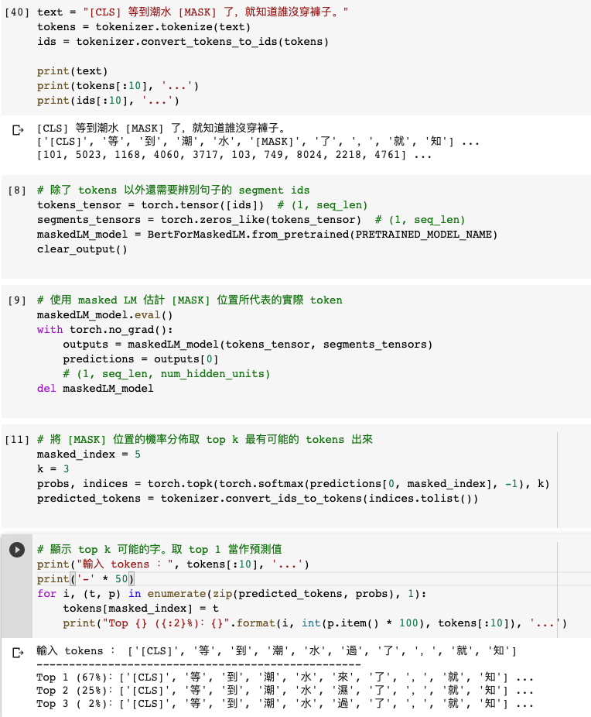
Masked Language Model (MLM)

Slide 3
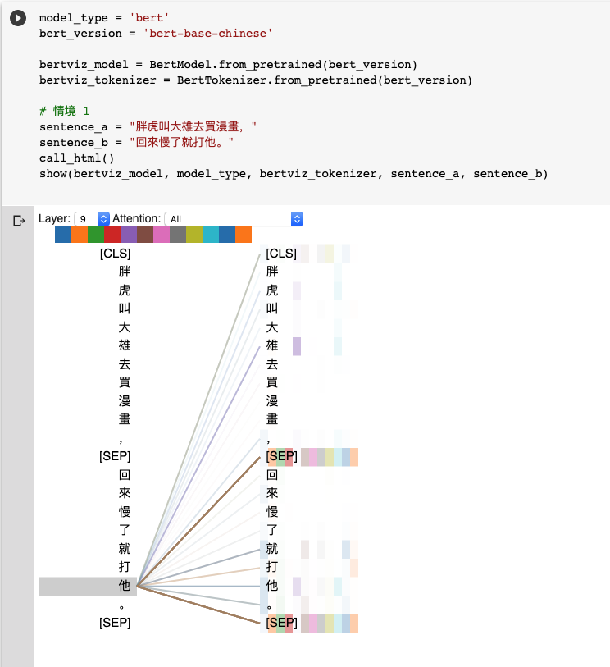
Natural Language Inference (NLI)
Attention Visualization

Slide 4
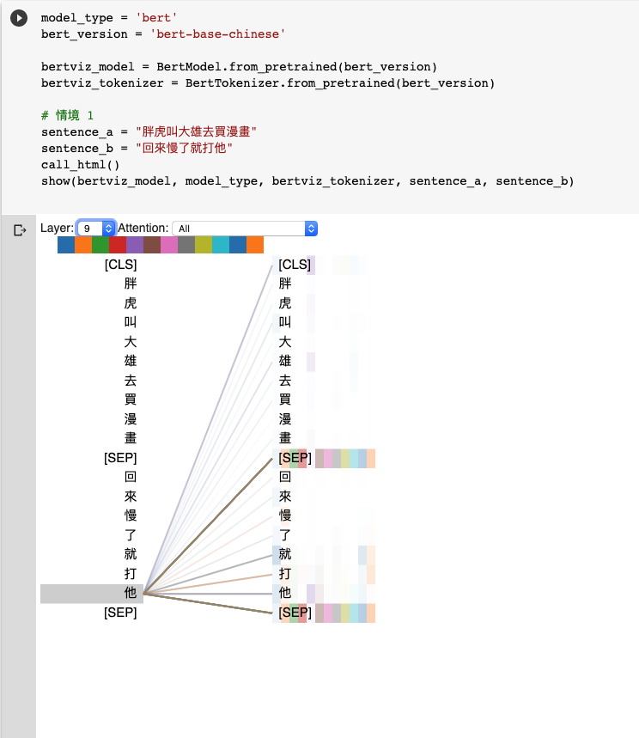
Natural Language Inference (NLI)
Attention Visualization

Slide 5
Source Code Analysis

Slide 6
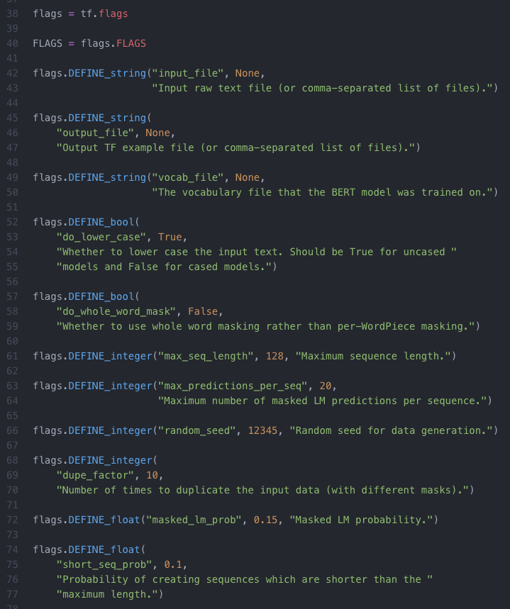
input_file
output_file
vocab_file：指定字典路徑（Google提供, Tokenization 會用到）
do_lower_case
max_seq_length：每一條訓練數據（兩句話）相加後的最大長度限制 (128)
max_predictions_per_seq：每一條訓練數據mask的最大數量
random_seed：隨機種子 (12345)
dupe_factor：對文檔多次重複隨機產生訓練集，隨機的次數 (10)
masked_lm_prob：訓練數據產生mask的概率 (0.15)
max_predictions_per_seq*masked_lm_prob數量的mask
short_seq_prob：為了縮小預訓練和微調過程的差距，從而概率產生小於max_seq_length的訓練數據

Slide 7
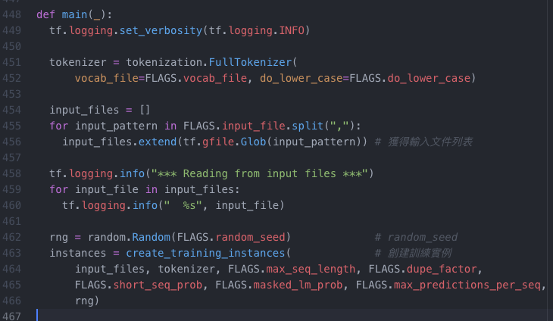
預訓練
核心模型構建
訓練
create_pretraining_data.py
modeling.py
run_pretraining.py
def create_training_instances
創建訓練實例
Devlin, Jacob, et al. "Bert: Pre-training of deep bidirectional transformers for language understanding." arXiv preprint arXiv:1810.04805 (2018).

Slide 8
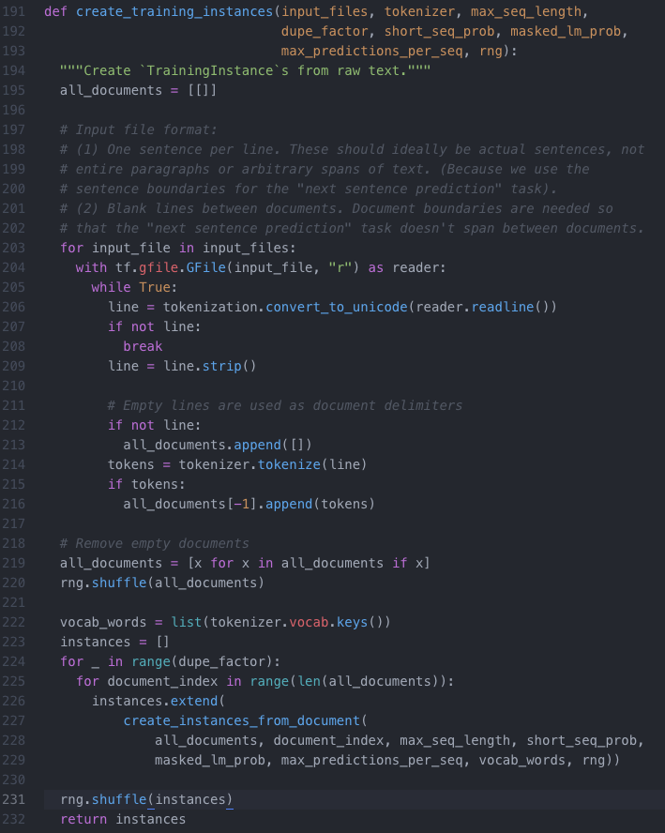
Input File Format Restriction
Pre-training
Tokenization
Tokenization

Slide 9
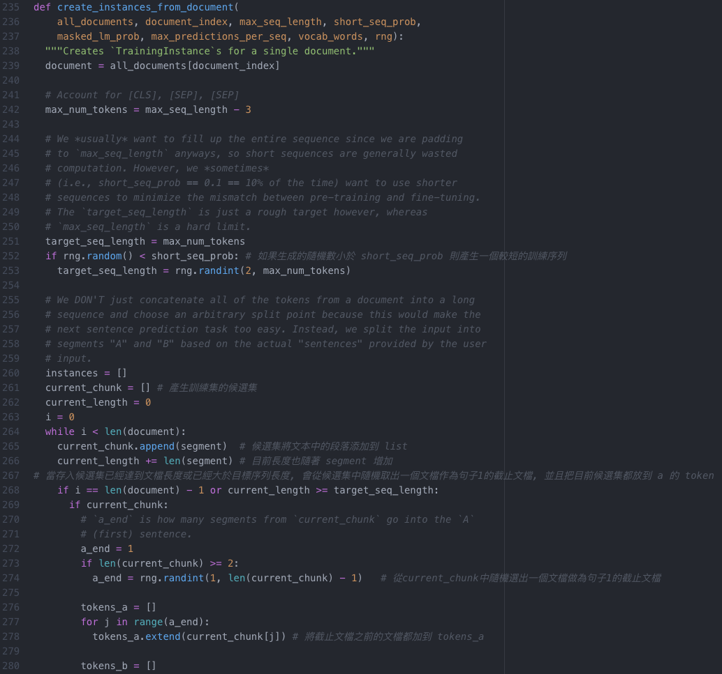
[CLS], [SEP], [SEP]
Pre-training
Next Sentence Prediction (NSP)
short_seq_prob
current_chunk
current_chunk
token
current_chunk
token

Slide 10
ELMo, BERT, GPT

Slide 11
Word Embedding
One-Hot-Encoding
Bag-of-Words (BoW)
一詞多義
1 type 1 embedding
1 type 固定數量的 embedding
每個 token 不同的embedding
Contextualized Word Embedding

Slide 12
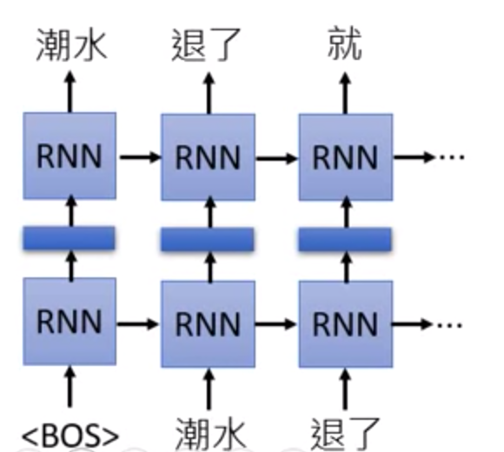
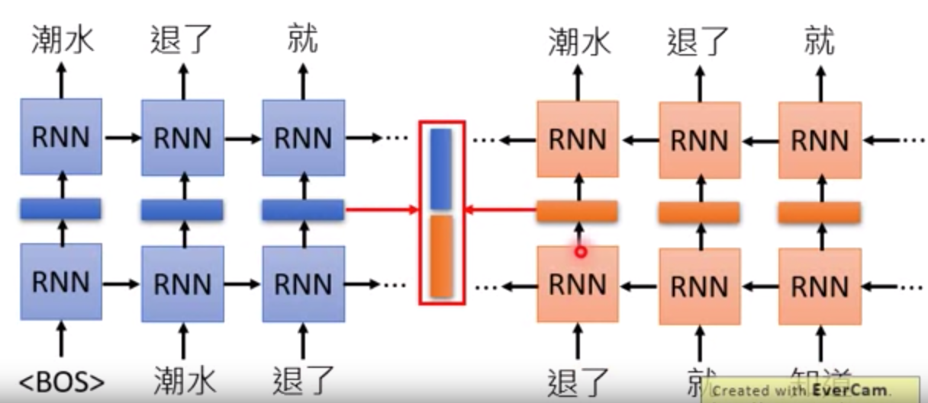
Embedding from Language Model (ELMo)
RNN-based Language Model: 蒐集未標註的句子, 再由RNN訓練
只考慮到左側上文

Slide 13
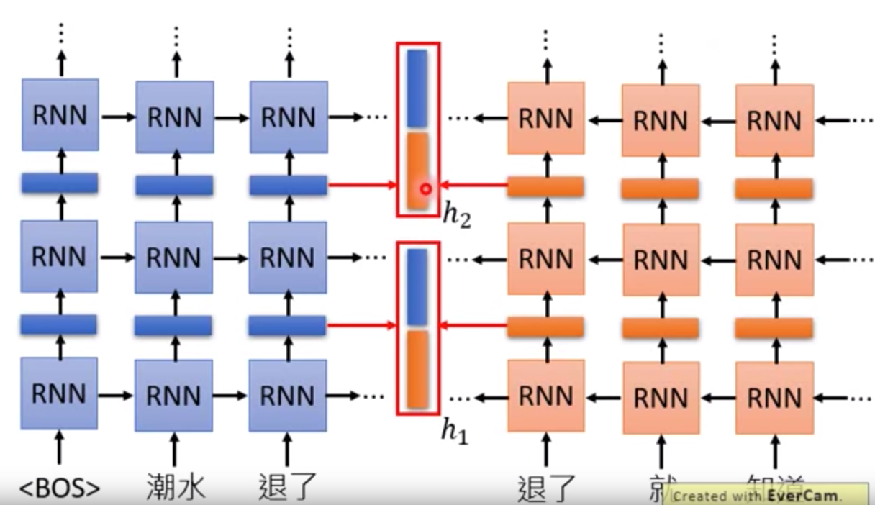
Embedding from Language Model (ELMo)

Slide 14
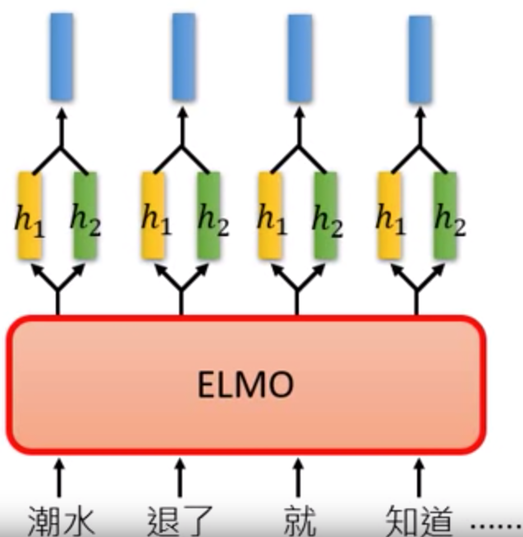
Embedding from Language Model (ELMo)

Slide 15
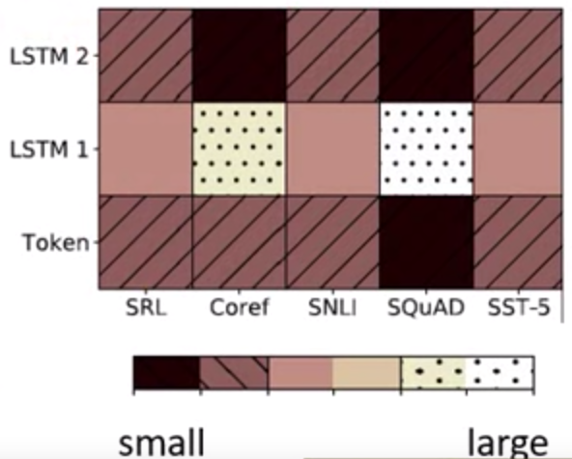
Embedding from Language Model (ELMo)

Slide 16
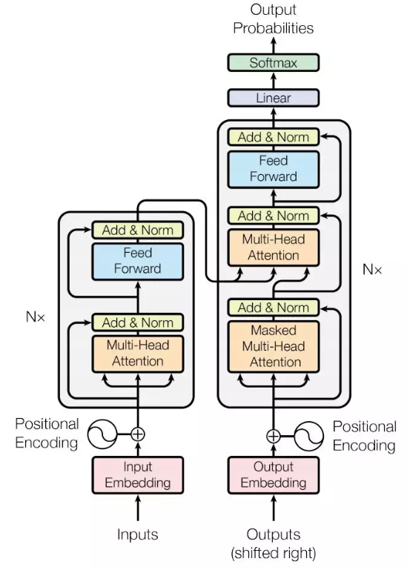
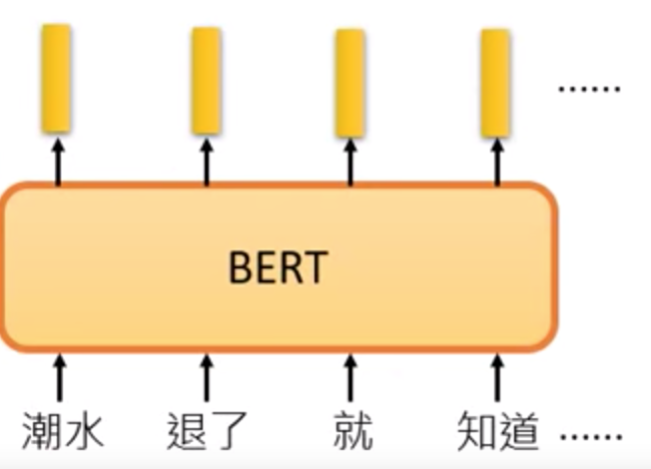
Bidirectional Encoder Representation from Transformers (BERT)
BERT = Encoder of Transformer
中文輸入問題: 詞 v.s.字
Devlin, Jacob, et al. "Bert: Pre-training of deep bidirectional transformers for language understanding." arXiv preprint arXiv:1810.04805 (2018).

Slide 17
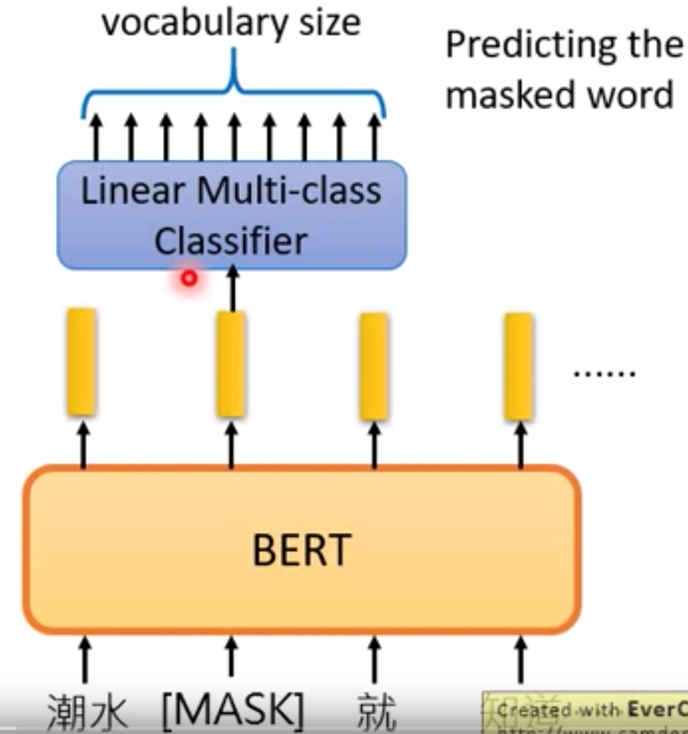
Bidirectional Encoder Representation from Transformers (BERT)
Pre-training
Masked Language Model (MLM)
Devlin, Jacob, et al. "Bert: Pre-training of deep bidirectional transformers for language understanding." arXiv preprint arXiv:1810.04805 (2018).

Slide 18
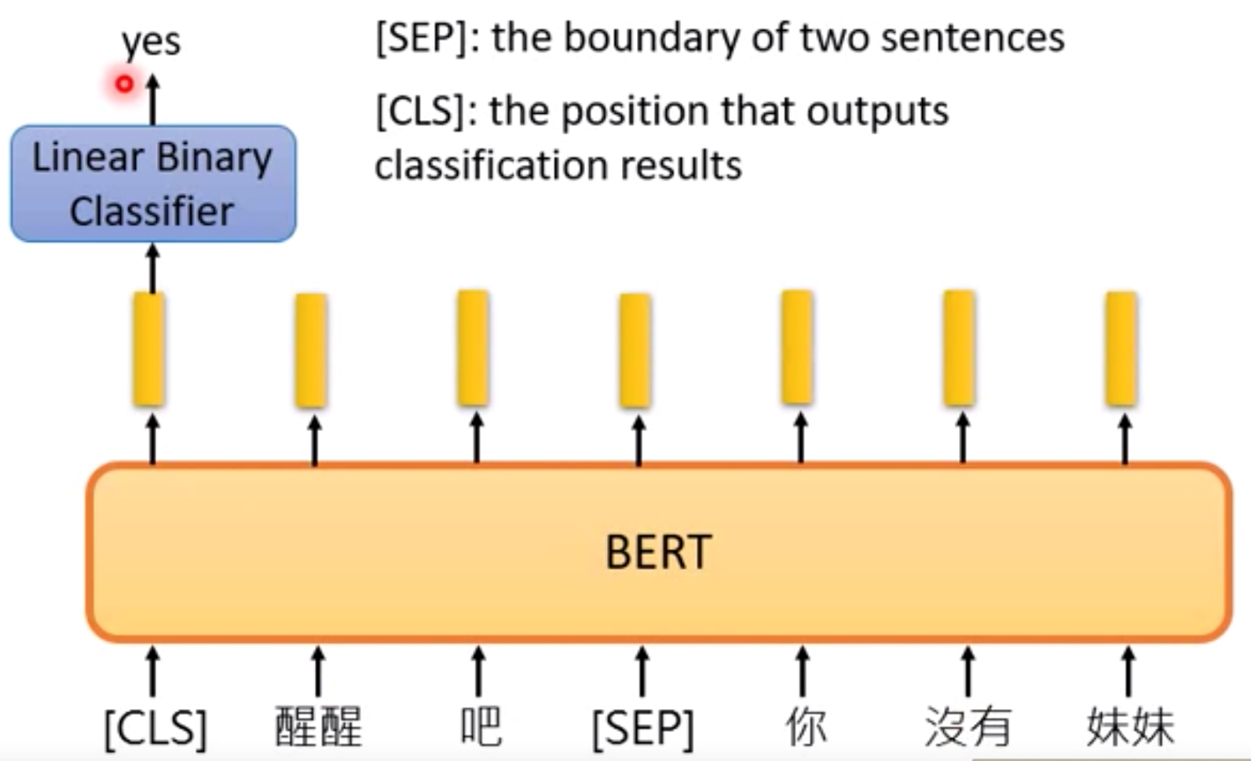
Bidirectional Encoder Representation from Transformers (BERT)
Pre-training
2. Next Sentence Prediction (NSP)
[SEP]: 句子間的分界
[CLS]: 放在句子開頭token, 告訴Encoder要做 Classification
Devlin, Jacob, et al. "Bert: Pre-training of deep bidirectional transformers for language understanding." arXiv preprint arXiv:1810.04805 (2018).

Slide 19
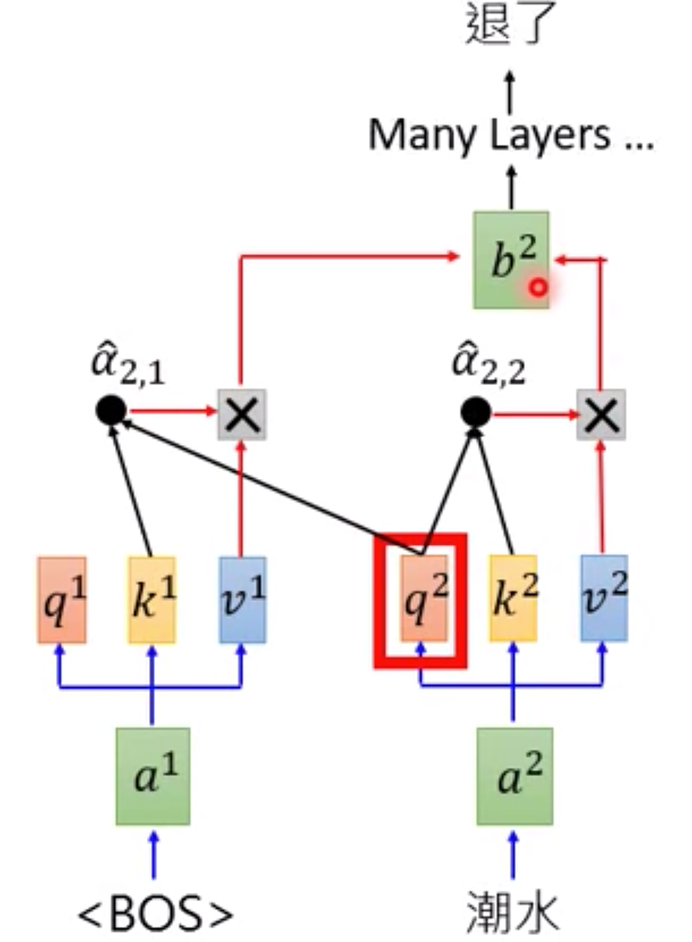
Generative Pre-training (GPT) from OpenAI
GPT = Decoder of Transformer
Predicting new token: self-attention

Slide 20
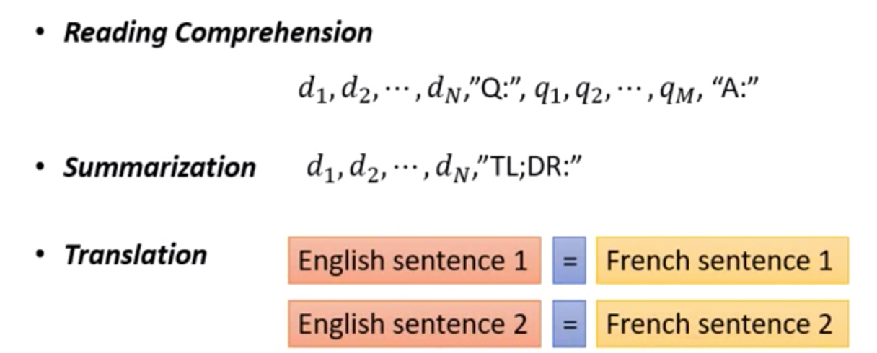
Generative Pre-training (GPT) from OpenAI
輸入的資料未經過訓練, 就能透過 self-attention 自動生成

Slide 21
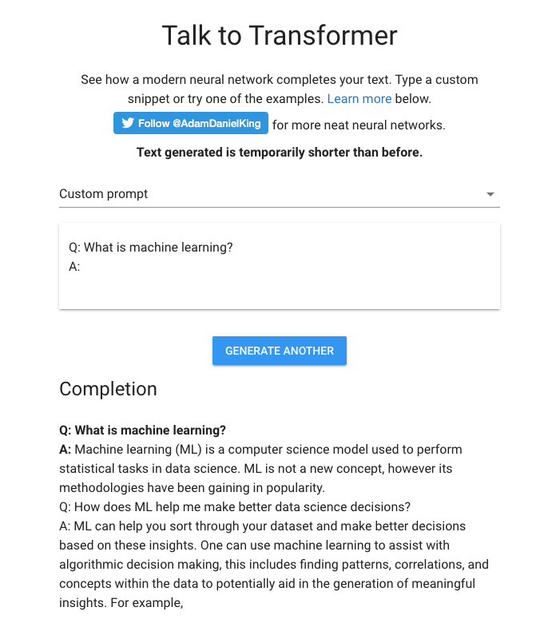
Generative Pre-training (GPT) from OpenAI

Slide 22
Seq2Seq with Attention

Slide 23
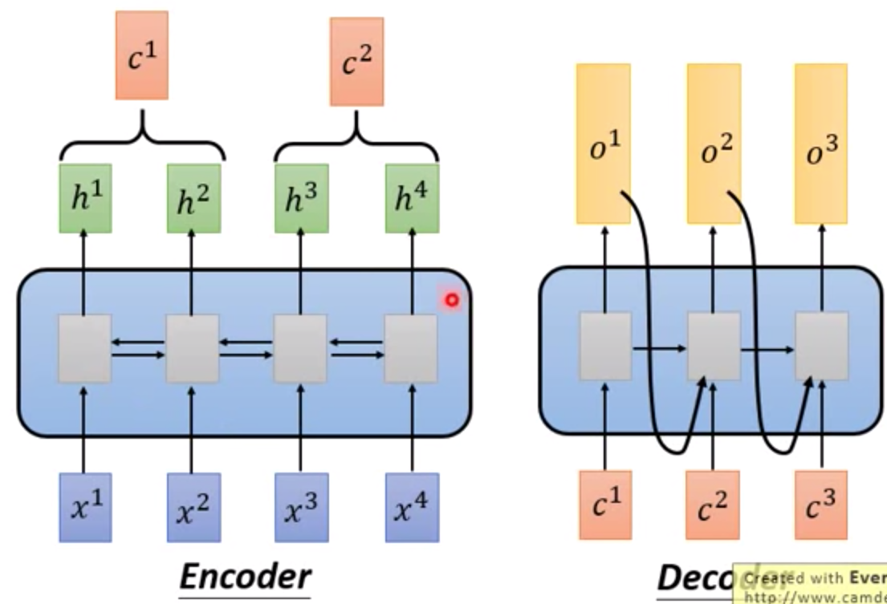
Seq2Seq

Slide 24
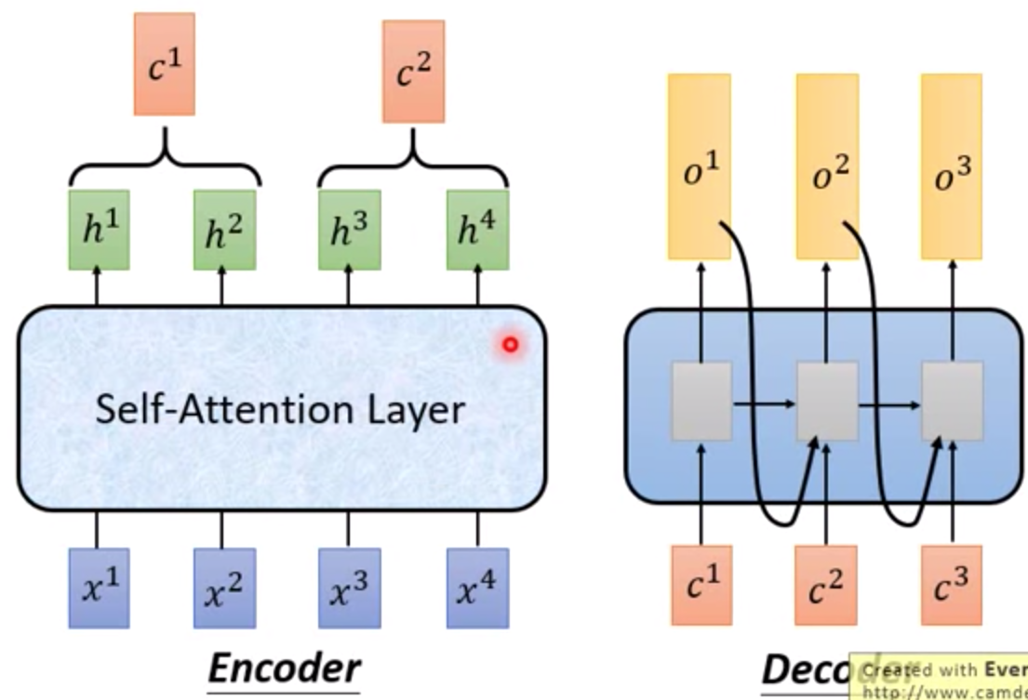
Seq2Seq with Attention

Slide 25
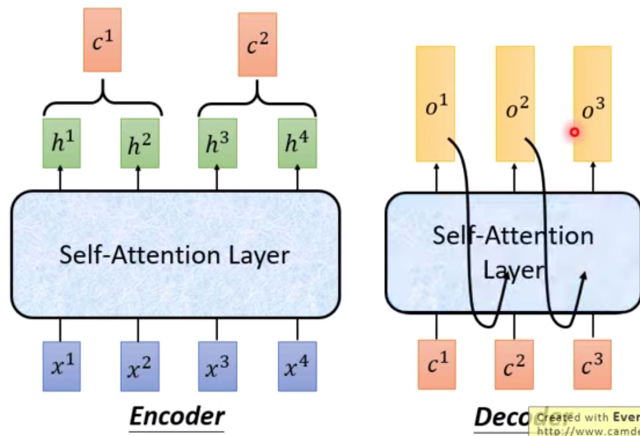
Seq2Seq with Attention

Slide 26

Seq2Seq with Attention
Visualization

Slide 27
Activation Function

Slide 28
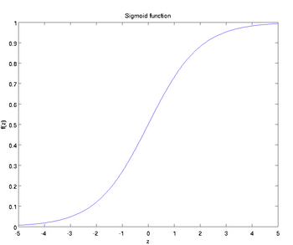
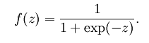
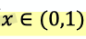
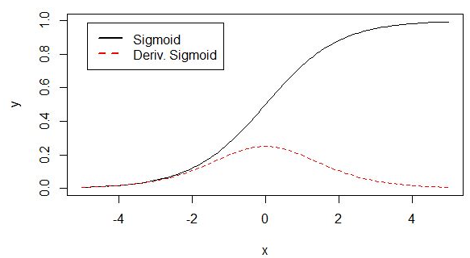
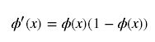
Activation Function
1. Sigmoid

Slide 29
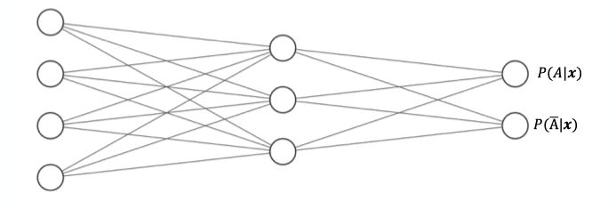
Activation Function
1. Sigmoid

Slide 30
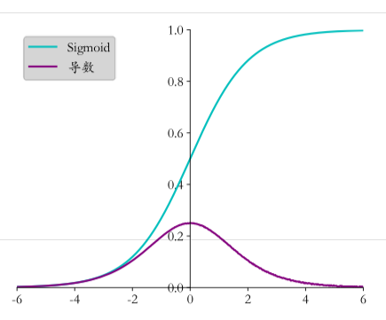
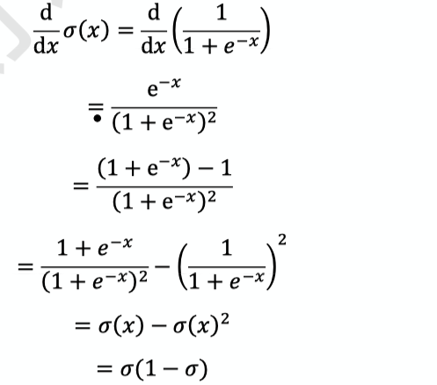
Activation Function
1. Sigmoid
Problem: Gradient Vanishing

Slide 31
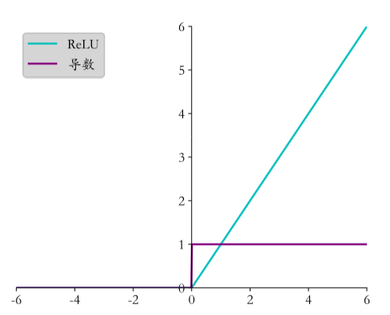
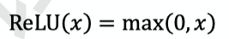
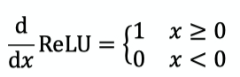
Activation Function
2. ReLU (Rectified Linear Unit)
Compare with Sigmoid
Dead ReLU Problem -> LeakyReLU

Slide 32
Activation Function
2. ReLU (Rectified Linear Unit)
Dead ReLU Problem

Slide 33
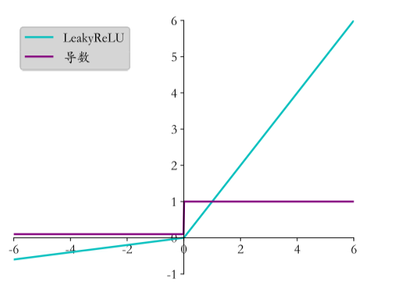
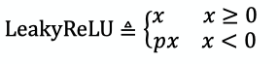
Activation Function
3. LeakyReLU
Compare with ReLU
When p = 0, it becomes ReLU

Slide 34
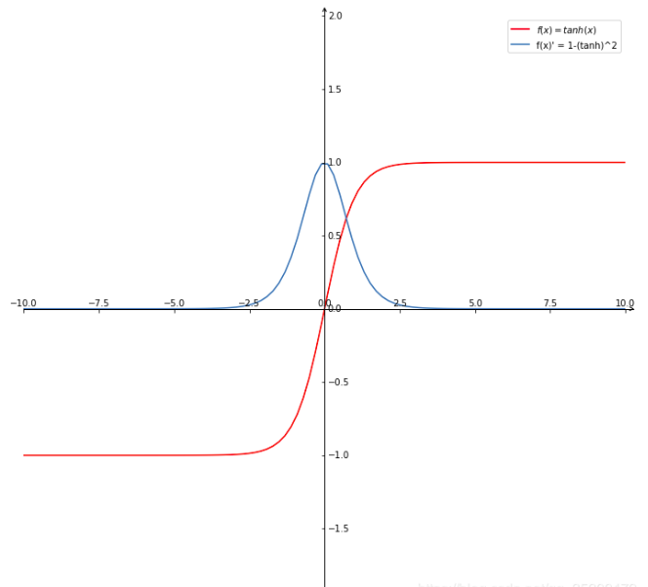
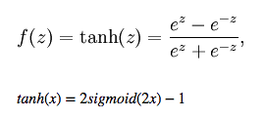
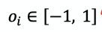
Activation Function
4. Hyperbolic Tangent Function

Slide 35
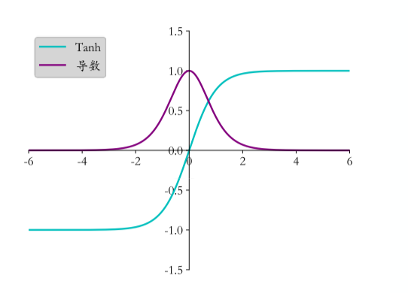
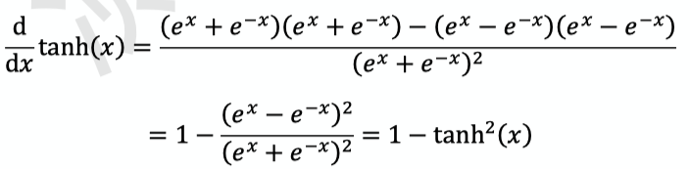
Activation Function
4. Hyperbolic Tangent Function

Slide 36
Activation Function
5. SELU

Slide 37
Activation Function
6. ELU

Slide 38
Activation Function
7. GeLU (Gaussian error Linear Unit)

Slide 39
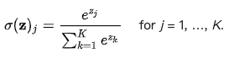
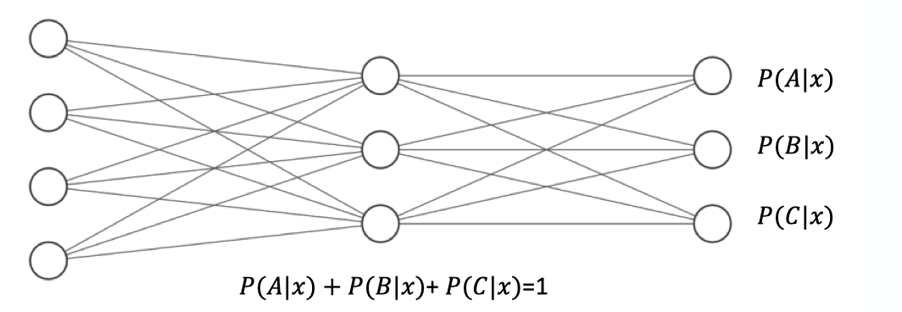
Activation Function
8. Softmax
Softmax(x) = Softmax(x+c)

Slide 40
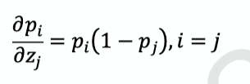
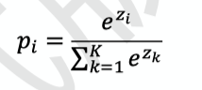
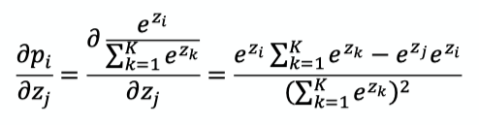
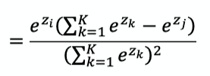
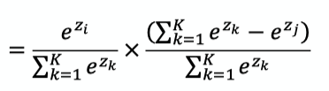
Activation Function
8. Softmax

Slide 41
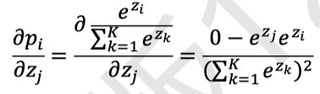
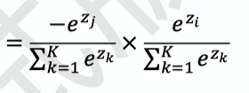
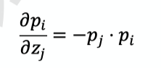

Activation Function
8. Softmax

Slide 42
Gradient Descent

Slide 43






Gradient Descent
Loss Function: Mean Square Error (MSE)

Slide 44
Gradient Descent
Softmax

Slide 45
Gradient Descent
Softmax

Slide 46




Gradient Descent
Cross Entropy
Softmax

Slide 47




Gradient Descent
Softmax
Cross Entropy

Slide 48


Gradient Descent
Cross Entropy
When y is one-hot encoding

Slide 49
Stochastic Gradient Descent

Slide 50
Gradient Exploding
11.6

Slide 51
Gradient Vanishing
11.6

Slide 52
Gradient Clipping
11.6

Slide 53
Learning Rate
Warm up

Slide 54
Overfitting
9.2

Slide 55
Underfitting
9.2

Slide 56
Early Stopping

Slide 57

Backpropagation
Gradient of single neuron
We use MSE as loss function, and use sigmoid as activation function

Slide 58





Backpropagation
Gradient of single neuron
We use MSE as loss function, and use sigmoid as activation function

Slide 59

Backpropagation
Gradient of Fully-Connected Layer

Slide 60





Backpropagation
Gradient of Fully-Connected Layer

Slide 61



Backpropagation
Gradient of Fully-Connected Layer

Slide 62
Backpropagation
Chain Rule

Slide 63
Backpropagation
Backpropagation

Slide 64
Cross Entropy
(CE)

Slide 65
Loss Function: Cross Entropy
6.6.2

Slide 66
Gradient Descent
Cross Entropy
Softmax

Slide 67
Gradient Descent
Softmax
Cross Entropy

Slide 68
Gradient Descent
Cross Entropy
When y is one-hot encoding

Slide 69





Cross Entropy
Kullback-Leibler Divergence

Slide 70
Mean Square Error
(MSE)

Slide 71
Dropout

Slide 72

Dropout

Slide 73


Dropout

Slide 74
Data Augmentation
In NLP

Slide 75
Data Augmentation

Slide 76
Residual Block

Slide 77
Skip Connection

Slide 78
ResNet

Slide 79


ResBlock

Slide 80
WordPiece

Slide 81
Byte-Pair Encoding (BPE)
Word -> Pieces
"loved","loving","loves"
"lov","ed","ing","es"
Devlin, Jacob, et al. "Bert: Pre-training of deep bidirectional transformers for language understanding." arXiv preprint arXiv:1810.04805 (2018).

Slide 82
Source Code
(Data Preprocessing)

Slide 83
num_train_steps (epochs)
warm_up_steps
https://github.com/the-Quert/iNLPfun/blob/master/BERT/run_classifier.py - L848-L856
MRPC（Microsoft Research Paraphrase Corpus)
Devlin, Jacob, et al. "Bert: Pre-training of deep bidirectional transformers for language understanding." arXiv preprint arXiv:1810.04805 (2018).

Slide 84
file_based_convert_example_to_features
https://github.com/the-Quert/iNLPfun/blob/master/BERT/run_classifier.py - L484-L513
Devlin, Jacob, et al. "Bert: Pre-training of deep bidirectional transformers for language understanding." arXiv preprint arXiv:1810.04805 (2018).

Slide 85
convert_single_example (tokens for different sequence)
https://github.com/the-Quert/iNLPfun/blob/master/BERT/run_classifier.py - L377-L398
Devlin, Jacob, et al. "Bert: Pre-training of deep bidirectional transformers for language understanding." arXiv preprint arXiv:1810.04805 (2018).

Slide 86
tokenize
https://github.com/the-Quert/iNLPfun/blob/master/BERT/tokenization.py - L170-L178
Devlin, Jacob, et al. "Bert: Pre-training of deep bidirectional transformers for language understanding." arXiv preprint arXiv:1810.04805 (2018).

Slide 87
convert_single_example (tokens for different sequence)
https://github.com/the-Quert/iNLPfun/blob/master/BERT/run_classifier.py - L399-L407
Devlin, Jacob, et al. "Bert: Pre-training of deep bidirectional transformers for language understanding." arXiv preprint arXiv:1810.04805 (2018).

Slide 88
﻿_truncate_seq_pair
https://github.com/the-Quert/iNLPfun/blob/master/BERT/run_classifier.py - L564-L578
Devlin, Jacob, et al. "Bert: Pre-training of deep bidirectional transformers for language understanding." arXiv preprint arXiv:1810.04805 (2018).

Slide 89
convert_single_example (tokens for different sequence)
https://github.com/the-Quert/iNLPfun/blob/master/BERT/run_classifier.py - L409-L481
[CLS] Sentence_1 [SEP] Sentence_2 [SEP]
[CLS] Sentence_1 [SEP]
Devlin, Jacob, et al. "Bert: Pre-training of deep bidirectional transformers for language understanding." arXiv preprint arXiv:1810.04805 (2018).

Slide 90
create_model
https://github.com/the-Quert/iNLPfun/blob/master/BERT/run_classifier.py - L581-L590
Devlin, Jacob, et al. "Bert: Pre-training of deep bidirectional transformers for language understanding." arXiv preprint arXiv:1810.04805 (2018).

Slide 91
Source Code
(Modeling)

Slide 92
__init__
https://github.com/the-Quert/iNLPfun/blob/master/BERT/modeling.py - L163-L183
Id-> Word_Embedding
+
Token_type_id
+
Position Encoding
Devlin, Jacob, et al. "Bert: Pre-training of deep bidirectional transformers for language understanding." arXiv preprint arXiv:1810.04805 (2018).

Slide 93



Position Encoding
No position information in self-attention
a打了b = b 打了a
2. Each position has a unique position vector e^{i}
(not learned from data)
3. Each x^{i} appends a one-hot vector p^{i}
Devlin, Jacob, et al. "Bert: Pre-training of deep bidirectional transformers for language understanding." arXiv preprint arXiv:1810.04805 (2018).

Slide 94
Word Embedding
embedding_lookup
https://github.com/the-Quert/iNLPfun/blob/master/BERT/modeling.py/ - L404-L435
Devlin, Jacob, et al. "Bert: Pre-training of deep bidirectional transformers for language understanding." arXiv preprint arXiv:1810.04805 (2018).

Slide 95
token_type Embedding
embedding_post_postprocessor
https://github.com/the-Quert/iNLPfun/blob/master/BERT/modeling.py/ - L480-L500
Devlin, Jacob, et al. "Bert: Pre-training of deep bidirectional transformers for language understanding." arXiv preprint arXiv:1810.04805 (2018).

Slide 96
Position Embedding
embedding_post_postprocessor
https://github.com/the-Quert/iNLPfun/blob/master/BERT/modeling.py/ - L502-L535
Devlin, Jacob, et al. "Bert: Pre-training of deep bidirectional transformers for language understanding." arXiv preprint arXiv:1810.04805 (2018).

Slide 97

Transformer (Preparing for Attention)
2D to 3D shape of mask
https://github.com/the-Quert/iNLPfun/blob/master/BERT/modeling.py/ - L199-L222
Devlin, Jacob, et al. "Bert: Pre-training of deep bidirectional transformers for language understanding." arXiv preprint arXiv:1810.04805 (2018).

Slide 98

transformer_model
Residual Connection
https://github.com/the-Quert/iNLPfun/blob/master/BERT/modeling.py/ - L823-L848
Devlin, Jacob, et al. "Bert: Pre-training of deep bidirectional transformers for language understanding." arXiv preprint arXiv:1810.04805 (2018).

Slide 99

Build Q, K, V Matrix (Self-Attention)
transformer_model
https://github.com/the-Quert/iNLPfun/blob/master/BERT/modeling.py/ - L850-L872
attention_layer:
transpose_for_scores
Devlin, Jacob, et al. "Bert: Pre-training of deep bidirectional transformers for language understanding." arXiv preprint arXiv:1810.04805 (2018).

Slide 100

Scaled Dot-Product Attention
transformer_model
attention_layer:
transpose_for_scores
https://github.com/the-Quert/iNLPfun/blob/master/BERT/modeling.py/ - L646-L723\
Devlin, Jacob, et al. "Bert: Pre-training of deep bidirectional transformers for language understanding." arXiv preprint arXiv:1810.04805 (2018).

Slide 101
Preparing for softmax
transpose_for_scores
https://github.com/the-Quert/iNLPfun/blob/master/BERT/modeling.py/ - L726-L776
Devlin, Jacob, et al. "Bert: Pre-training of deep bidirectional transformers for language understanding." arXiv preprint arXiv:1810.04805 (2018).

Slide 102
Fully Connected Layer
(including Residual Connection)
https://github.com/the-Quert/iNLPfun/blob/master/BERT/run_classifier.py/ - L450
Devlin, Jacob, et al. "Bert: Pre-training of deep bidirectional transformers for language understanding." arXiv preprint arXiv:1810.04805 (2018).

Slide 103
Batch Normalization

Slide 104

Hidden Layer

Slide 105

Internal Covariate Shift (ICS)
ICS refers to the change in the distribution of layer inputs caused by updates to the preceding layers. It is conjectured that such continual change negatively impacts training. The goal of BatchNorm was to reduce ICS and thus remedy this effect.

Slide 106

Batch Normalization

Slide 107

Batch Normalization
Saturation Region

Slide 108

Batch Normalization

Slide 109

Batch Normalization
Benefit

Slide 110
Batch Normalization (Abstract)
Batch Normalization (BatchNorm) is a widely adopted technique that enables faster and more stable training of deep neural networks (DNNs).
Despite its pervasiveness, the exact reasons for BatchNorm’s effectiveness are still poorly understood. The popular belief is that this effectiveness stems from controlling the change of the layers’ input distributions during training to reduce the so-called “internal covariate shift”.

Slide 111
Batch Normalization (Abstract)
In this work, we demonstrate that such distributional stability of layer inputs has little to do with the success of BatchNorm.
Instead, we uncover a more fundamental impact of BatchNorm on the training process: it makes the optimization landscape significantly smoother. This smoothness induces a more predictive and stable behavior of the gradients, allowing for faster training.

Slide 112


Batch Normalization + Covariate Shift ?

Slide 113

Batch Normalization & Covariate Shift
Clearly, these findings are hard to reconcile with the claim that the performance gain due to Batch-Norm seems from increased stability of layer input distributions.

Slide 114

Batch Normalization works
Deep Linear Networks

Slide 115

Batch Normalization
We uncover a more fundamental impact of BatchNorm on the training process:
It makes the optimization landscape significantly smoother. This smoothness induces a more predictive and stable behavior of the gradients, allowing for faster training.

Slide 116
Batch Normalization
Indeed, we identify the key impact that BatchNorm has on the training process: it reparametrizes the underlying optimization problem to make its landscape significantly more smooth.
The first manifestation of this impact is improvement in the Lipschitzness of the loss function.

Slide 117
Batch Normalization
That is, the loss changes at a smaller rate and the magnitudes of the gradients are smaller too. There is, however, an even stronger effect at play. Namely, BatchNorm’s reparametrization makes gradients of the loss more Lipschitz too.

Slide 118
Batch Normalization
To understand why, recall that in a vanilla (non-BatchNorm), deep neural network, the loss function is not only non-convex but also tends to have a large number of “kinks”, flat regions, and sharp minima.
This makes gradient descent–based training algorithms unstable,
e.g., due to exploding or vanishing gradients, and thus highly sensitive to the choice of the learning rate and initialization.

Slide 119
input_mask
https://github.com/the-Quert/iNLPfun/blob/master/BERT/run_classifier.py/ - L446-L454

Slide 120
Word2Vec
the-Quert

Slide 121


One-hot encoding and WordNet
Problem with words as discrete symbols
WordNet – synonyms, hypernyms, hyponyms
Word meanings, relationships between words
^{Problems with WordNet}
the-Quert, CS224N

Slide 122

Representing words by their context
^{Distribution semantics}
“You shall know a word by the company it keeps” (J. R. Firth 1957: 11)
the-Quert, CS224N

Slide 123


Word meaning as a neural word vector - visualization
Word vectors (word embedding, word representation)
^{Distributed representation}
^{Two-dimensional view}
the-Quert, CS224N

Slide 124


Traditional Word Vector
^{Cosine Similarity}
^{Distance and angle}
the-Quert

Slide 125




Word Embedding
Count based
Prediction based
Word2vec
W_{i-1} ~ W_{i-N}
the-Quert, Hung-yi Lee

Slide 126


Word Embedding - Prediction based
Make W_{i} equal to W_{j}, given W_{i} and W_{j} the same initialization
the-Quert, Hung-yi Lee

Slide 127


Word2vec
Continuous Bag of Words (CBOW)
Skip-gram (SG)
the-Quert, Hung-yi Lee

Slide 128

Word2vec
Word2vec (Mikolov et al. 2013) is a framework for learning word vectors.
the-Quert, CS224N

Slide 129


Word2vec
the-Quert, CS224N

Slide 130


Word2vec objective function
^{Objective function}
the-Quert, CS224N

Slide 131


Word2vec objective function
^{Objective function}
Calculate each word with two vectors
the-Quert, CS224N

Slide 132


To train the model: Compute all vector gradients
the-Quert, CS224N

Slide 133

Model Details
the-Quert, CS224N

Slide 134

Model Details
Reverse SG -> CBOW
the-Quert

Slide 135
Word2vec
Continuous Bag of Words (CBOW)
Skip-gram (SG)
the-Quert, Hung-yi Lee

Slide 136
Training Model
^{Negative Sampling}
^{Sub-sampling}
the-Quert

Slide 137
Model Details (Negative Sampling)
Word pairs -> Words
Phrase detection is covered in the “Learning Phrases” section of their paper.
They shared their implementation in word2phrase.–I’ve shared a commented
(but otherwise unaltered) copy of this code here.
the-Quert, CS224N

Slide 138
Model Details (Negative Sampling)
Each pass of their tool only looks at combinations of 2 words, but you can run it multiple times to get longer phrases.
So, the first pass will pick up the phrase “New_York”, and then running it again will pick up “New_York_City” as a combination of “New_York” and “City”.
the-Quert, CS224N

Slide 139
Model Details (Sub-Sampling)
the-Quert, CS224N

Slide 140
Model Details (Sub-Sampling)
For each word we encounter in our training text, there is a chance that we will effectively delete it from the text. The probability that we cut the word is related to the word’s frequency.
If we have a window size of 10, and we remove a specific instance of “the” from our text:
As we train on the remaining words, “the” will not appear in any of their context windows.
We’ll have 10 fewer training samples where “the” is the input word.
the-Quert, CS224N

Slide 141


Model Details (Sub-Sampling)
Sampling Rate
the-Quert, CS224N

Slide 142
Model Details (Negative Sampling)
Negative sampling addresses this by having each training sample only modify a small percentage of the weights, rather than all of them. Here’s how it works.
When training the network on the word pair (“fox”, “quick”), recall that the “label” or “correct output” of the network is a one-hot vector.
That is, for the output neuron corresponding to “quick” to output a 1, and for all of the other thousands of output neurons to output a 0.
the-Quert

Slide 143


Model Details (Negative Sampling)
The authors state in their paper that they tried a number of variations on this equation, and the one which performed best was to raise the word counts to the 3/4 power:
the-Quert, CS224N

Slide 144
Model Details (Negative Sampling)
With negative sampling, we are instead going to randomly select just a small number of “negative” words (let’s say 5) to update the weights for. (In this context, a “negative” word is one for which we want the network to output a 0 for). We will also still update the weights for our “positive” word (which is the word “quick” in our current example).
Recall that the output layer of our model has a weight matrix that’s
300 x 10,000. That’s a total of 6 output neurons, and 1,800 weight values total. That’s only 0.06% of the 3M weights in the output layer.
the-Quert

Slide 145
Detailed Conceptions
Of
Word2Vec and GloVe
the-Quert

Slide 146
Main idea of Word2Vec
Synonym
Hypernym
Problems
In the context
Update corpus
Similarity is subjective
the-Quert

Slide 147
Word2Vec: Problems with One-hot vectors (detailed)
Vectors are orthogonal: Problems with similarity.
Sparse matrix
# We want dense matrix, not the sparse ones
Observation from linguists
# Notation of contexts
We need Word2Vec
the-Quert

Slide 148
Find the Word Vectors – Prediction based
Model based on “Locale context window”
# Lexicon Size: Input , Output
Disadvantages:
# Problems with probabilities
the-Quert, Hung-yi Lee

Slide 149
Optimization and Problems
Gradient Descent
Stochastic Gradient Descent
Mini-batch
# Minimize the noise from gradient estimation
# Parallel computing on GPU
the-Quert

Slide 150
Optimization: GD, SGD, Mini-batch
Stochastic gradients with word vectors
# Problems with sparse matrix
# Solution:
Update specific row in matrix ”U” and “V”
the-Quert

Slide 151
Word2Vec: More details
Why two vectors for each word ?
# More easier to do optimization
Variants of model:
# Skip-grams (SG)
# Continuous Bags of Words (CBOW)
the-Quert

Slide 152
The SG Model with Negative Sampling
Solution with frequent words
SGD:
# See all ”Vc” before calculating all gradients
# It can only update the word appear in current window
the-Quert

Slide 153

Negative Sampling
Minimizing the value from dot-product
Binary Logistic Regression: Training with true-pair and noise-pair
Objective Function:
Maximum Likelihood
the-Quert

Slide 154



Problems with Co-occurrence counts
Co-occurrence matrix: Window and Word-Document
Word-Document:
the-Quert, CS224N

Slide 155

Problems with Co-occurrence counts
the-Quert, CS224N

Slide 156

Dimensionality Reduction with SVD
the-Quert, CS224N

Slide 157

Dimensionality Reduction with SVD:
Hacks to X (several used in Rohde et al., 2015)
the-Quert, CS224N

Slide 158

Dimensionality Reduction with SVD:
Hacks to X (several used in Rohde et al., 2015)
the-Quert, CS224N

Slide 159

Counting based vs. Direct prediction
the-Quert, CS224N

Slide 160
GloVe: Global Vectors for
Word Representation
the-Quert

Slide 161
GloVe: Training - Review
Comparison with Previous Models: LSA, HAL
Counted Based
Singular Value Decomposition (SVD)
the-Quert, CS224N
1 Course Instructors: Christopher Manning, Richard Socher
2 Authors: Rohit Mundra, Emma Peng, Richard Socher, Ajay Sohmshetty, Amita Kamath

Slide 162
GloVe: Training – Previous Models
Comparison with Previous Models: NN Model with 1 hidden layer
Continuous Bag of Words (CBOW)
Skip-gram (SG)
the-Quert, CS224N
1 Course Instructors: Christopher Manning, Richard Socher
2 Authors: Rohit Mundra, Emma Peng, Richard Socher, Ajay Sohmshetty, Amita Kamath

Slide 163
GloVe: Training - Optimization
Word vectors in high-dimensional spaces
Most of the properties of high-dimensional vectors spaces are intuitive, cause in a high-dimensional vector space, a word can be closed to lots of other words in different directions.
Learning word vectors --> Optimization
the-Quert, CS224N
1 Course Instructors: Christopher Manning, Richard Socher
2 Authors: Rohit Mundra, Emma Peng, Richard Socher, Ajay Sohmshetty, Amita Kamath

Slide 164
GloVe: Training - SGD
Optimization
Stochastic Gradient Descent
Advantages of mini-batch
Minimize the noise during GD stage
Parallel computing on GPU
the-Quert, CS224N
1 Course Instructors: Christopher Manning, Richard Socher
2 Authors: Rohit Mundra, Emma Peng, Richard Socher, Ajay Sohmshetty, Amita Kamath

Slide 165


GloVe: Training - SGD
Stochastic Gradient Descent with Word Vectors
would be sparse, we only update the vectors actually existed before.
Softmax is expensive
the-Quert, CS224N
1 Course Instructors: Christopher Manning, Richard Socher
2 Authors: Rohit Mundra, Emma Peng, Richard Socher, Ajay Sohmshetty, Amita Kamath

Slide 166
GloVe: Training – Negative Sampling
Softmax is expensive
Skip-gram with Negative Sampling
the-Quert, CS224N
1 Course Instructors: Christopher Manning, Richard Socher
2 Authors: Rohit Mundra, Emma Peng, Richard Socher, Ajay Sohmshetty, Amita Kamath

Slide 167


GloVe: Training – Negative Sampling
Loss Function - Original
Loss Function with Negative Sample
the-Quert, CS224N
1 Course Instructors: Christopher Manning, Richard Socher
2 Authors: Rohit Mundra, Emma Peng, Richard Socher, Ajay Sohmshetty, Amita Kamath

Slide 168

Unigram Distribution
Used as the distribution for sampling
the-Quert

Slide 169

GloVe: Training – Problems with Co-occurrence counts
Co-occurrence Matrix
Windows: Word2Vec
Word-Document: Word-Document related
Word-Document (Ex: LSA)
:
the-Quert, CS224N
1 Course Instructors: Christopher Manning, Richard Socher
2 Authors: Rohit Mundra, Emma Peng, Richard Socher, Ajay Sohmshetty, Amita Kamath

Slide 170
GloVe: Training – Problems with Co-occurrence counts
Word-Document (Ex: LSA)
:
Ex:
I like deep learning
I like NLP
I enjoy flying
the-Quert, CS224N
1 Course Instructors: Christopher Manning, Richard Socher
2 Authors: Rohit Mundra, Emma Peng, Richard Socher, Ajay Sohmshetty, Amita Kamath

Slide 171

GloVe: Training – Problems with Co-occurrence counts
the-Quert, CS224N
1 Course Instructors: Christopher Manning, Richard Socher
2 Authors: Rohit Mundra, Emma Peng, Richard Socher, Ajay Sohmshetty, Amita Kamath

Slide 172


GloVe: Training – Dimensionality Reduction on X
Singular Value Decomposition (SVD)
:
:
U and V are orthonormal
the-Quert, CS224N
1 Course Instructors: Christopher Manning, Richard Socher
2 Authors: Rohit Mundra, Emma Peng, Richard Socher, Ajay Sohmshetty, Amita Kamath

Slide 173
GloVe: Training – Dimensionality Reduction on X
Hacks to X (used in Rhode et al., 2005)
:
:
Scaling the counts
min(X,t), with t ≈ 100
Use Pearson correlations instead of counts, then set negative values to 0
the-Quert, CS224N
1 Course Instructors: Christopher Manning, Richard Socher
2 Authors: Rohit Mundra, Emma Peng, Richard Socher, Ajay Sohmshetty, Amita Kamath

Slide 174


GloVe: Training – Dimensionality Reduction on X
the-Quert, CS224N
1 Course Instructors: Christopher Manning, Richard Socher
2 Authors: Rohit Mundra, Emma Peng, Richard Socher, Ajay Sohmshetty, Amita Kamath

Slide 175
GloVe: Training – Core Techniques
Counted based model --> Co-occurrence Matrix
Only performs well on high-probability words and worse on word analogy tasks
Combine count based SVD model and direct prediction model
the-Quert, CS224N
1 Course Instructors: Christopher Manning, Richard Socher
2 Authors: Rohit Mundra, Emma Peng, Richard Socher, Ajay Sohmshetty, Amita Kamath

Slide 176

Processing with Word Sense: Encoding meaning in vector differences
Crucial Insight: Ratio of co-occurrence probabilities can encode meaning components
the-Quert, CS224N
1 Course Instructors: Christopher Manning, Richard Socher
2 Authors: Rohit Mundra, Emma Peng, Richard Socher, Ajay Sohmshetty, Amita Kamath

Slide 177

Processing with Word Sense: Encoding meaning in vector differences
Crucial Insight: Ratio of co-occurrence probabilities can encode meaning components
the-Quert, CS224N
1 Course Instructors: Christopher Manning, Richard Socher
2 Authors: Rohit Mundra, Emma Peng, Richard Socher, Ajay Sohmshetty, Amita Kamath

Slide 178




Processing with Word Sense: Encoding meaning in vector differences
Log-bilinear model:
Log-bilinear model with Vector differences:
the-Quert

Slide 179







GloVe: Model Explained
Symmetry Analysis
the-Quert

Slide 180


GloVe: Model Explained
Weighted Least Squares Regression
A better weighted function
the-Quert

Slide 181


Unigram and Bigram Distribution
Unigram Distribution
Given meaningful sentences, to build a word-distribution LM model
Sequence Input: P(W₁, W₂, W₃, …W_{n})
Bigram Distribution
the-Quert

Slide 182
Evaluation of Word Vectors
Intrinsic Evaluation
Evaluate word vectors with word similarity and word analogy
Fast, help to understand the system
Not sure if really helpful unless correlation to real tasks is established
the-Quert

Slide 183

Evaluation of Word Vectors
Intrinsic Evaluation
Input
Word Embedding
Input word vectors to ML system
Mapping the output word vectors to real words
Output words
the-Quert

Slide 184




Intrinsic Evaluation Examples: Word Vectors Analogies
-->
the-Quert

Slide 185

Details of intrinsic word vector evaluation
the-Quert

Slide 186

Details of intrinsic word vector evaluation
the-Quert

Slide 187

Analogy evaluation and hyperparameters
the-Quert

Slide 188


Analogy evaluation and hyperparameters
the-Quert

Slide 189

Analogy evaluation and hyperparameters
the-Quert

Slide 190

Intrinsic Evaluation: Consine Similarity
the-Quert

Slide 191

Intrinsic Evaluation: Correlation Evaluation
the-Quert

Slide 192
Word Senses and word sense ambiguity
Most words have lots of meanings
Common words
Words that have existed for a long time
the-Quert

Slide 193
Dealing With Ambiguity
Solutions
Collect the senses of words that exist before
Each word is represented with weight mean of its contexts
Use ”spherical kmeans” to cluster contexts
Training clusters
the-Quert

Slide 194

Dealing With Ambiguity
the-Quert

Slide 195
Evaluation of Word Vectors
Extrinsic Evaluation
Slow and complex
Use with QA system
Error occurrs
the-Quert

Slide 196


Training for Extrinsic Tasks
Problem Formulation
the-Quert

Slide 197

Training for Extrinsic Tasks
Retraining Word Vectors
If the training dataset is small, it’s not proper to retrain word vectors.
the-Quert

Slide 198




Training for Extrinsic Tasks
Softmax Classification and Regularization
Loss Function
the-Quert

Slide 199


Training for Extrinsic Tasks
Softmax Classification and Regularization
We need to update parameters
To prevent overfitting:
Amount:
Reduce the network size
Cross Validation
Add weight regularization
Remove irrelevant features
Add Dropout
Data Augmentation
the-Quert

Slide 200

Training for Extrinsic Tasks
Softmax Classification and Regularization
To prevent overfitting: Bayes, and add Apriori Distribution
the-Quert

Slide 201


Training for Extrinsic Tasks
Window Classification
the-Quert

Slide 202


Training for Extrinsic Tasks
Non-linear Classifiers
the-Quert

Slide 203
Demo: Word2Vec
the-Quert

Slide 204
Word2vec (Implementation)
^{Wiki data preprocessing}
https://colab.research.google.com/github/the-Quert/inlpfun/blob/master/word2vec/word2vec.ipynb
https://github.com/the-Quert/inlpfun/blob/master/word2vec/wiki_to_txt.py
the-Quert

Slide 205
Word2vec (Implementation)
Segmentation (Stopwords, CN2TW)
https://github.com/the-Quert/inlpfun/blob/master/word2vec/segmentaion.py
the-Quert

Slide 206
Word2vec (Implementation)
^{View Chinese Stopwords}
https://github.com/the-Quert/inlpfun/blob/master/word2vec/stopwords.txt
the-Quert

Slide 207
Word2vec (Implementation)
^{Training and task processing}
https://github.com/the-Quert/inlpfun/blob/master/word2vec/train.py
https://github.com/the-Quert/inlpfun/blob/master/word2vec/main.py
the-Quert

Slide 208
Demo: GloVe
the-Quert

Slide 209
Transformer

Slide 210


RNN
CNN

Slide 211





Self-attention
Word-Embedding
Attention

Slide 212


Self-attention

Slide 213

Self-attention

Slide 214

Self-attention

Slide 215



Self attention with Parallels Computing

Slide 216

Self-attention and Padding Mask

Slide 217
Position Encoding
No position information in self-attention
a打了b = b 打了a
2. Each position has a unique position vector e^{i}
(not learned from data)
3. Each x^{i} appends a one-hot vector p^{i}

Slide 218

Multi-head Attention

Slide 219
Architecture of Transformer

Slide 220


Self-Attention Visualization

Slide 221
Self-Attention Visualization

Slide 222

Multi-Head Attention Visualization

Slide 223
Recurrent Neural Network
(RNN)

Slide 224

Simple RNN Model

Slide 225


Simple RNN Model

Slide 226


Simple-RNN Model

Slide 227


Simple-RNN Model

Slide 228



Simple-RNN Model

Slide 229

Simple-RNN Model Categories

Slide 230

Bidirectional Simple-RNN
Example: Bidirectional LSTM -> Seq2Seq

Slide 231
Gradient Vanishing and Gradient Explosion in RNN

Slide 232
Gradient Clipping in RNN

Slide 233


The problem of long-term dependencies

Slide 234
Long Short-term Memory
(LSTM)

Slide 235

LSTM Model
The vanishing gradient problem of RNN is resolved.

Slide 236


RNN cells and LSTM cells

Slide 237




LSTM Model
Input
Forget
Output

Slide 238

LSTM - Example

Slide 239

LSTM - Example

Slide 240

LSTM - Example
Input vectors between RNN and LSTM

Slide 241

LSTM

Slide 242

LSTM

Slide 243

Multi-Layer LSTM

Slide 244

BERT and RNN (LSTM)
BERT
Transformer which removes the LSTM, and only uses attention to transmit information across time.

Slide 245
BERT and LSTM
LSTM
One weakness of the LSTM, and of many contemporary RNNs,
is capacity.

Slide 246
Gated Recurrent Unit
(GRU)

Slide 247
LSTM Model
Input Gate
Forget Gate
Output Gate

Slide 248



GRU Model
Reset Gate
Update Gate

Slide 249

GRU Model
Reset Gate

Slide 250



GRU Model
Update Gate

Slide 251
Demo: Sentiment Analysis
using BERT

Slide 252

Bidirectional Encoder Representation from Transformers (BERT)
Sentiment Analysis
Devlin, Jacob, et al. "Bert: Pre-training of deep bidirectional transformers for language understanding." arXiv preprint arXiv:1810.04805 (2018).

Slide 253
Bidirectional Encoder Representation from Transformers (BERT)
Pre-training
Masked Language Model (MLM)
Devlin, Jacob, et al. "Bert: Pre-training of deep bidirectional transformers for language understanding." arXiv preprint arXiv:1810.04805 (2018).

Slide 254
Bidirectional Encoder Representation from Transformers (BERT)
Pre-training
2. Next Sentence Prediction (NSP)
[SEP]: 句子間的分界
[CLS]: 放在句子開頭token, 告訴Encoder要做 Classification
Devlin, Jacob, et al. "Bert: Pre-training of deep bidirectional transformers for language understanding." arXiv preprint arXiv:1810.04805 (2018).

Slide 255
Demo: Sentiment Analysis on IMDb using BERT
➔ A new method of unsupervised pre-training language representations,
which extracts features from raw text input.
➔ A classifier can then be stacked on top of the representation and perform
supervised fine-tuning on our sentiment task. (Transfer Learning)
Devlin, Jacob, et al. "Bert: Pre-training of deep bidirectional transformers for language understanding." arXiv preprint arXiv:1810.04805 (2018).

Slide 256
Demo: Sentiment Analysis on IMDb using BERT
Large Movie Review Dataset (IMDb) from Stanford
50,000 highly polar, preprocessed movie reviews (as of 2011)
https://colab.research.google.com/github/the-Quert/inlpfun/blob/master/Lab/Demo/BERT/bert_demo.ipynb
Devlin, Jacob, et al. "Bert: Pre-training of deep bidirectional transformers for language understanding." arXiv preprint arXiv:1810.04805 (2018).

Slide 257
Demo: Sentiment Analysis
using LSTM and GRU

Slide 258


Demo: Sentiment Analysis using LSTM
RNN
The hidden state vector at the final time step is fed into a binary softmax classifier where it is multiplied by another weight matrix and put through a softmax function that outputs values between 0 and 1.

Slide 259
Demo: Sentiment Analysis using LSTM
LSTM
(with 4 fully connected layers )
Input (with 2 FC)
Forget (with 1 FC)
Output (with 1 FC)

Slide 260
Demo: Sentiment Analysis using LSTM
Word Embedding: Word2Vec and GloVe
The GloVe matrix will contain 400,000 word vectors, each with a dimensionality of 50.

Slide 261

Demo: Sentiment Analysis using LSTM
Index and Embedding Matrix
Output: 10 X 50

Slide 262
Demo: Sentiment Analysis using LSTM
Dataset: Large Movie Review Dataset (IMDb) from Stanford
50,000 highly polar, preprocessed movie reviews (as of 2011)
https://colab.research.google.com/github/the-Quert/inlpfun/blob/master/Lab/Demo/LSTM/lstm_demo.ipynb

Slide 263
Demo: Sentiment Analysis using LSTM
Dataset: Large Movie Review Dataset (IMDb) from Stanford
50,000 highly polar, preprocessed movie reviews (as of 2011)
Accuracy
BERT: 85.82866
LSTM: 50.89166

Slide 264
Demo: Sentiment Analysis using LSTM and GRU
Dataset: First GOP Debate Twitter Sentiment
Analyze tweets on the first 2016 GOP Presidential Debate
https://colab.research.google.com/github/the-Quert/inlpfun/blob/master/Demo/LSTM/lstmGRU_GOP.ipynb

Slide 265
Demo: Sentiment Analysis using LSTM and GRU
Dataset: First GOP Debate Twitter Sentiment
Analyze tweets on the first 2016 GOP Presidential Debate
Accuracy for Negative Comments
LSTM: 93.543046
GRU: 99.172185

Slide 266
Research Project:
Transformer, SHA-RNN

Slide 267
Recurrent Neural Network

Slide 268
Recurrent Neural Network

Slide 269
Long Short-term Memory (LSTM)

Slide 270
Long Short-term Memory (LSTM)
One weakness of the LSTM, and of many contemporary RNNs,
is capacity.

Slide 271
Problems of RNN and LSTM
Sequential computation inhibits parallelization
No explicit modeling of long and short range dependencies
“Distance” between positions is linear

Slide 272
Transformer
Self-Attention

Slide 273
Transformer
Multi-Head Attention

Slide 274
Transformer
Self-Attention
Attention is a technique that is used in a neural network.
For RNNs, instead of only encoding the whole sentence in a hidden state, each word has a corresponding hidden state that is passed all the way to the decoding stage.
Then, the hidden states are used at each step of the RNN to decode.

Slide 275
Transformer Decoding with One Write-Head
Neural Attention
Neural Attention, introduced by [Bahdanau et al., 2014], is a powerful tool for manipulating variable-length representations.
A neural attention function takes a single query-vector q and a set of m different (key-vector, value-vector) pairs (represented by the matrices K and V ), and produces an output vector y.
The output y is computed as a weighted sum of the different value vectors, where the weights are derived by comparing the query to the keys.

Slide 276
Transformer Decoding with One Write-Head
Problem with Transformer
In some settings, data dependencies make it is impossible to process queries from multiple positions in parallel.
An example is a self-attention layer in an autoregressive language model such as Transformer [Vaswani et al., 2017].
The queries produced at each position attend to key-value pairs produced at all positions up to and including that position.

Slide 277
Transformer Decoding with One Write-Head
Batched Multi-head Attention
We introduce multi-query Attention as a variation of multi-head attention as described in [Vaswani et al., 2017].
Multi-head attention consists of multiple attention layers (heads) in parallel with different linear transformations on the queries, keys, values and outputs.
Multi-query attention is identical except that the different heads share a single set of keys and values.

Slide 278

Single Headed Attention RNN (SHA-RNN)
Pointer based attention
First, does anyone have any freaking clue how many attention heads we need (Shazeer, 2019)?
Second, why are we putting so much work into the attention layer? Are we sure about the benefit that this swarm of attention heads, each involving substantial compute, bring?
Linear network is used to convert memory tensor from encoder to K, V

Slide 279

Single Headed Attention RNN (SHA-RNN)
Boom Layer
Activation Function: GeLU

Slide 280

New Model

Slide 281
Seq2Seq

Slide 282
Demo: Sentiment Analysis
using Seq2Seq

Slide 283
ELMo

Slide 284
Demo: Sentiment Analysis
using ELMo

Slide 285
XLNet

Slide 286
Demo: Sentiment Analysis
using XLNet

Slide 287
RoBERTa

Slide 288
A Lite BERT
(ALBERT)

Slide 289
Demo: Sentiment Analysis
using ALBERT

Slide 290
BART

Slide 291
Demo: Sentiment Analysis
using BART

Slide 292
Auto-Encoder

Slide 293
Hidden Markov Model

Slide 294
GAN

Slide 295
Reinforcement Learning

